Slide 1







Environmental Issues
12 programmes accredited
Ranked 801-1000 in Rankings 2024
Ranked 801-850 in
World Rankings 2025
Ranked 46th in
Rankings 2024*
A Grade

Slide 2
GLOBAL WARMING
Troposphere, the lowermost layer of the atmosphere, traps heat by a natural process due to the presence of certain gases. This effect is called Green House Effect as it is similar to the warming effect observed in the horticultural green house made of glass.
The amount of heat trapped in the atmosphere depends mostly on the concentrations of .heat trapping. or .green house. gases and the length of time they stay in the atmosphere.
The major green house gases are carbon dioxide, ozone, methane, nitrous oxide, chlorofluorocarbons (CFCs) and water vapours.
The average global temperature is 15°C.
In the absence of green house gases this temperature would have been -18°C.
Therefore, Green House Effect contributes a temperature rise to the tune of 33°C. Heat trapped by green house gases in the atmosphere keeps the planet warm enough to allow us and other species to exist.

Slide 3
The two predominant green house gases are water vapours, which are controlled by hydrological cycle, and carbon dioxide, which is controlled mostly by the global carbon cycle.
While the levels of water vapour in the troposphere have relatively remained constant, the levels of carbon dioxide have increased.
Other gases whose levels have increased due to human activities are methane, nitrous oxide and chlorofluorocarbons.
Deforestation has further resulted in elevated levels of carbon dioxide due to non-removal of carbon dioxide by plants through photosynthesis.
Warming or cooling by more than 2°C over the past few decades may prove to be disastrous for various ecosystems on the earth including humans, as it would alter the conditions faster than some species could adapt or migrate.
Some areas will become inhabitable because of drought or floods following a rise in average sea level.

Slide 4
Greenhouse Gases
The phenomenon that worries the environmental scientists is that due to anthropogenic activities there is an increase in the concentration of the greenhouse gases in the air that absorb infra-red light containing heat and results in the re-radiation of even more of the out going thermal infra-red energy, thereby increasing the average surface temperature beyond 15°C.
The phenomenon is referred to as the enhanced green house effect to distinguish its effect from the one that has been operating naturally for millennia.
The greenhouse gases present in the troposphere and resulting in an increase in the temperature of air and the earth.
Carbon dioxide
Chlorofluorocarbons (CFCs)
Methane (CH4)
Nitrous Oxide (N2O)

Slide 5
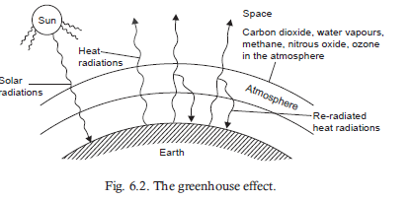

Slide 6
Impacts of Enhanced Greenhouse Effect
The enhanced greenhouse effect will not only cause global warming but will also affect various other climatic and natural processes.
Global temperature increase
Rise in Sea Level
Effects on Agriculture
Effects on Human Health

Slide 7
Impacts of Enhanced Greenhouse Effect (Contd..)
(i) Global temperature increase: It is estimated that the earth’s mean temperature will rise between 1.5 to 5.5°C by 2050 if input of greenhouse gases continues to rise at the present rate. Even at the lower value, earth would be warmer than it has been for 10,000 years.
(ii) Rise in Sea Level: With the increase in global temperature sea water will expand. Heating will melt the polar ice sheets and glaciers resulting in further rise in sea level. Current models indicate that an increase in the average atmospheric temperature of 3°C would raise the average global sea level by 0.2-1.5 meters over the next 50-100 years.
One meter rise in sea level will inundate low lying areas of cities like Shanghai, Cairo, Bangkok, Sydney, Hamburg and Venice as well as agricultural lowlands and deltas in Egypt, Bangladesh, India, China and will affect rice productivity. This will also disturb many commercially important spawning grounds, and would probably increase the frequency of storm damage to lagoons, estuaries and coral reefs.
In India, the Lakshadweep Islands with a maximum height of 4 meters above the level may be vulnerable. Some of the most beautiful cities like Mumbai may be saved by heavy investment on embankment to prevent inundation. Life of millions of people will be affected, by the sea level rise who have built homes in the deltas of the Ganges, the Nile, the Mekong, the Yangtze and the Mississippi rivers

Slide 8
Impacts of Enhanced Greenhouse Effect (Contd.)
(iii) Effects on Human Health: The global warming will lead to changes in the rainfall pattern in many areas, thereby affecting the distribution of vector-borne diseases like malaria, filariasis, elephantiasis etc.
Areas which are presently free from diseases like malaria, schistosomiasis etc. may become the breeding grounds for the vectors of such diseases. The areas likely to be affected in this manner are Ethiopia, Kenya and Indonesia. Warmer temperature and more water stagnation would favour the breeding of mosquitoes, snails and some
insects, which are the vectors of such diseases. Higher temperature and humidity will increase/aggravate respiratory and skin diseases.
(iv) Effects on Agriculture: There are different views regarding the effect of global warming on agriculture. It may show positive or negative effects on various types of crops in different regions of the world. Tropical and subtropical regions will be more affected since the average temperature in these regions is already on the higher side. Even a rise of 2°C may be quite harmful to crops. Soil moisture will decrease and evapo-transpiration will increase, which may drastically affect wheat and maize production. Increase in temperature and humidity will increase pest growth like the growth of vectors for various diseases. Pests will adapt to such changes better than the crops. To cope up with the changing situation drought resistant, heat resistant and pest resistant varieties of crops have to be developed

Slide 9
Slow down Global Warming
To slow down enhanced global warming the following steps will be important:
(i) Cut down the current rate of use of CFCs and fossil fuel.
(ii) Use energy more efficiently.
(iii) Shift to renewable energy resources.
(iv) Increase Nuclear Power Plants for electricity production.
(v) Shift from coal to natural gas.
(vi) Trap and use methane as a fuel.
(vii) Reduce beef production.
(viii) Adopt sustainable agriculture.
(ix) Stabilize population growth.
(x) Efficiently remove CO2 from smoke stacks.
(xi) Plant more trees.
(xii) Remove atmospheric CO2 by utilizing photosynthetic algae.

Slide 10
ACID RAIN
Oxides of sulfur and nitrogen originating from industrial operations and fossil fuel combustion are the major sources of acid forming gases.
Acid forming gases are oxidised over several days by which time they travel several thousand kilometers. In the atmosphere these gases are ultimately converted into sulfuric and nitric acids. Hydrogen chloride emission forms hydrochloric acid. These acids cause acidic rain.
Acid rain is only one component of acidic deposition.
Acidic deposition is the total of wet acidic deposition (acid rain) and dry deposition.
Rain water is turned acidic when its pH falls below 5.6
In fact clean or natural rain water has a pH of 5.6 at 20°C because of formation of carbonic acid due to dissolution of CO2 in water.

Slide 11
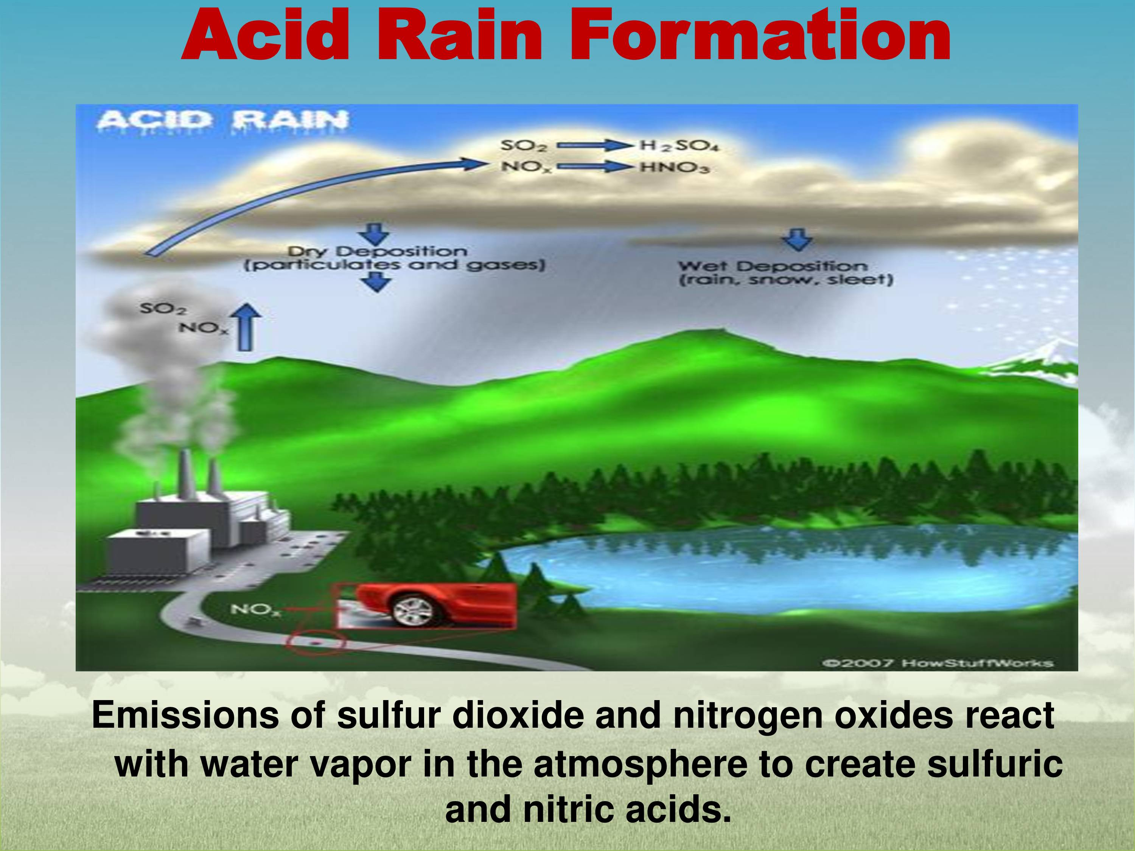

Slide 12
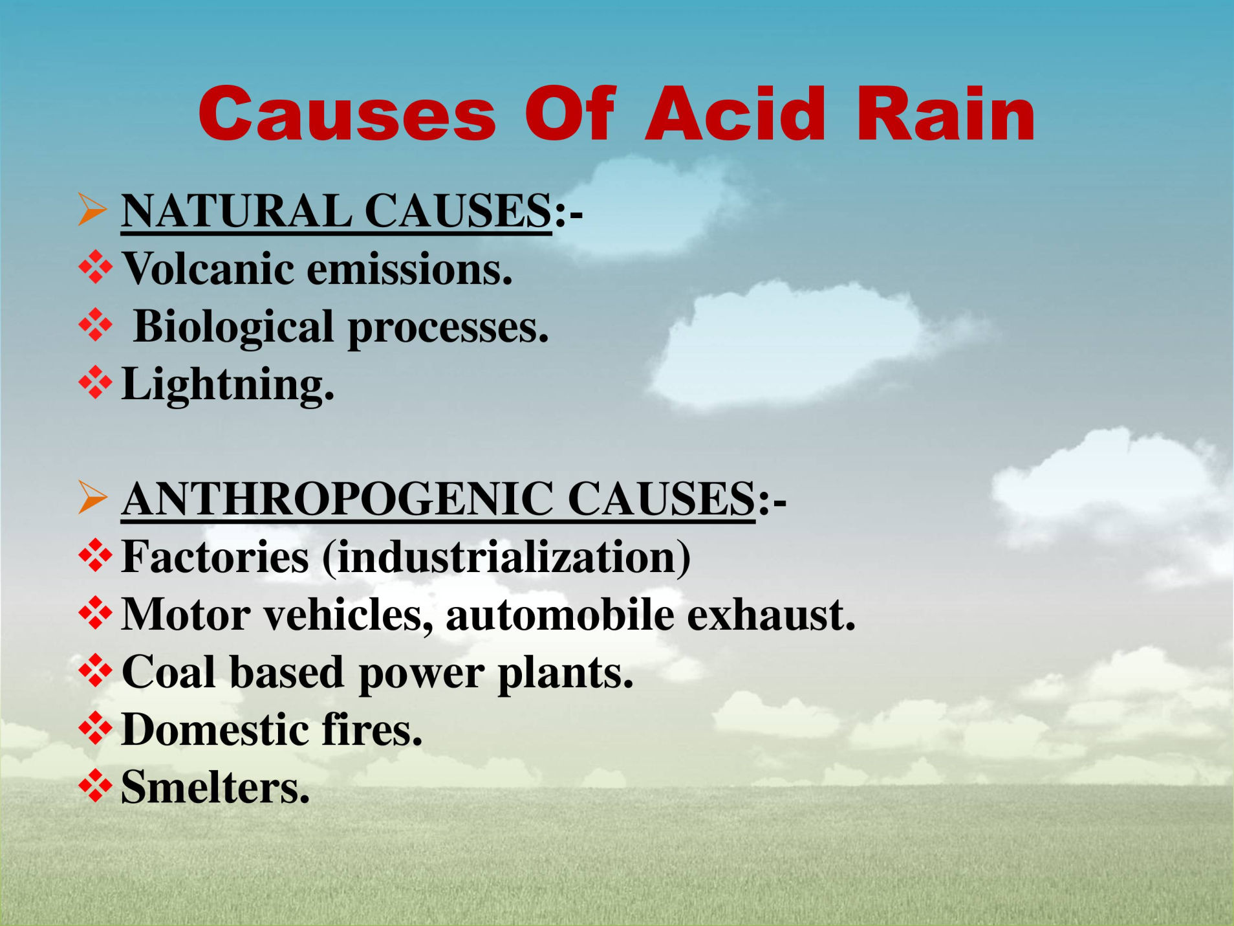

Slide 13
The Adirondack Lakes located in the state of New York are known to receive acid rains.
The strong acids like sulphuric acid (H2SO4) and nitric acid (HNO3) dissolved or formed in rainwater dissociate or release hydrogen ions thereby increasing the acidity in rain drops.
Generally sulfuric acid forms a major fraction of acid rain, followed by nitric acid and a very small fraction of other acids.
However, in urban areas calcium (Ca2+), Magnesium (Mg2+) and ammonium
(NH4+) ions help to neutralize the rain drops shifting the overall H+ towards basic scale.
The overall pH of any raindrop is due to the net effect of carbonic acid, sulfuric acid, nitric acid and other acidic

Slide 14
In the absence of rain, dry deposition of acid may occur.
Acid forming gases like oxides of sulphur and nitrogen and acid aerosols get deposited on the surface of water bodies, vegetation, soil and other materials.
On moist surfaces or in liquids these acid forming gases can dissolve and form acids similar to that formed in acid rain.
If the oxidizers are present on the liquid surfaces then these gases undergo
oxidation to form acids.
Fine particles or acid droplets can act as nuclei for water to condense to form rain droplets.
By such process sulfuric acid is incorporated into the droplets.
In the clouds additional SO₂ and NO₂contact the droplets and get absorbed which can be oxidized by the dissolved hydrogen peroxide (H₂O₂) or other oxidizers.
In the droplets falling from the clouds additional acidic gases and aerosol particles get incorporated, further decreasing their pH.

Slide 15
A unit decrease in pH value causes 10 times increase in acidity.
Average pH in rainfallover eastern United States from April 1979 to March 1980 was less than 5.0. In India acid rain is recorded from certain places:

Slide 16
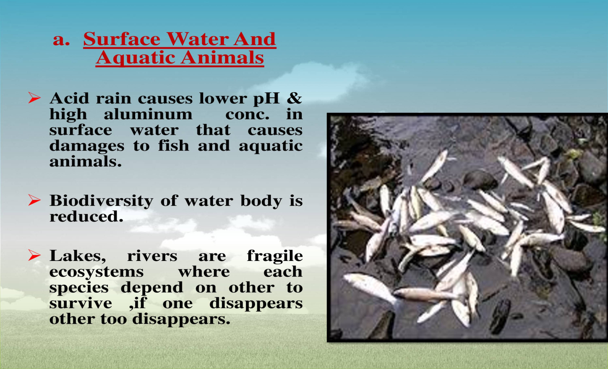
Adverse effects of Acid Rain

Slide 17
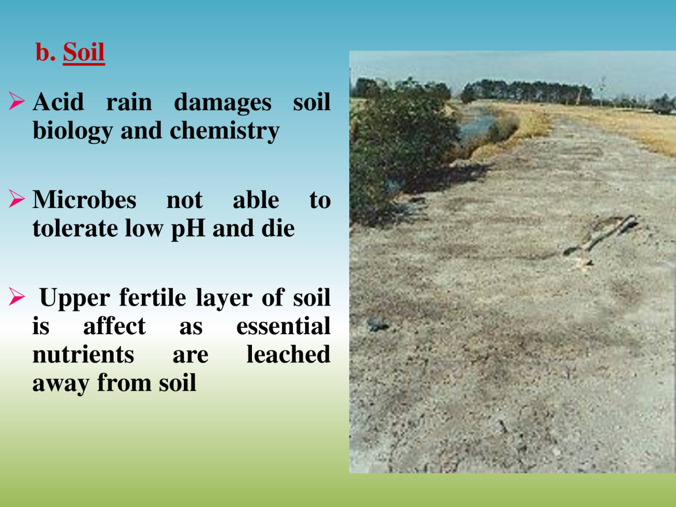
Adverse effects of Acid Rain

Slide 18
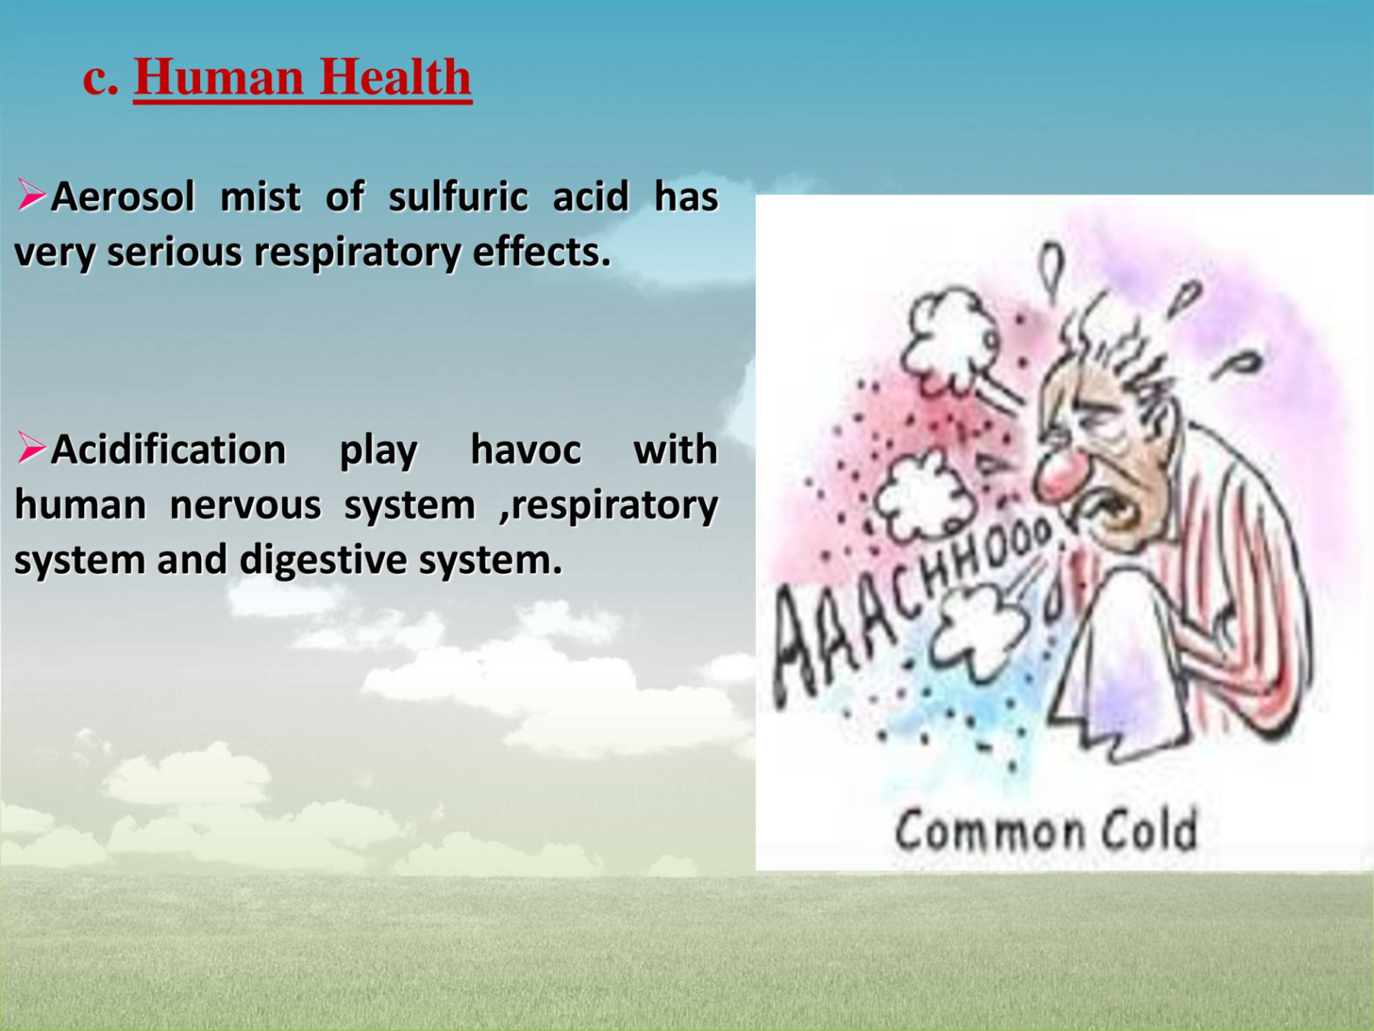
Adverse effects of Acid Rain

Slide 19
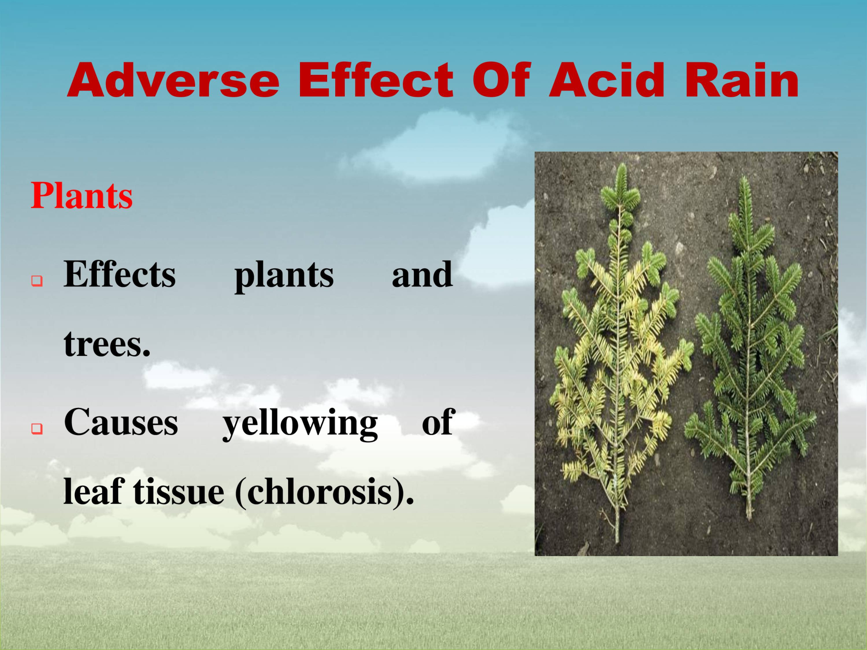
Adverse effects of Acid Rain

Slide 20
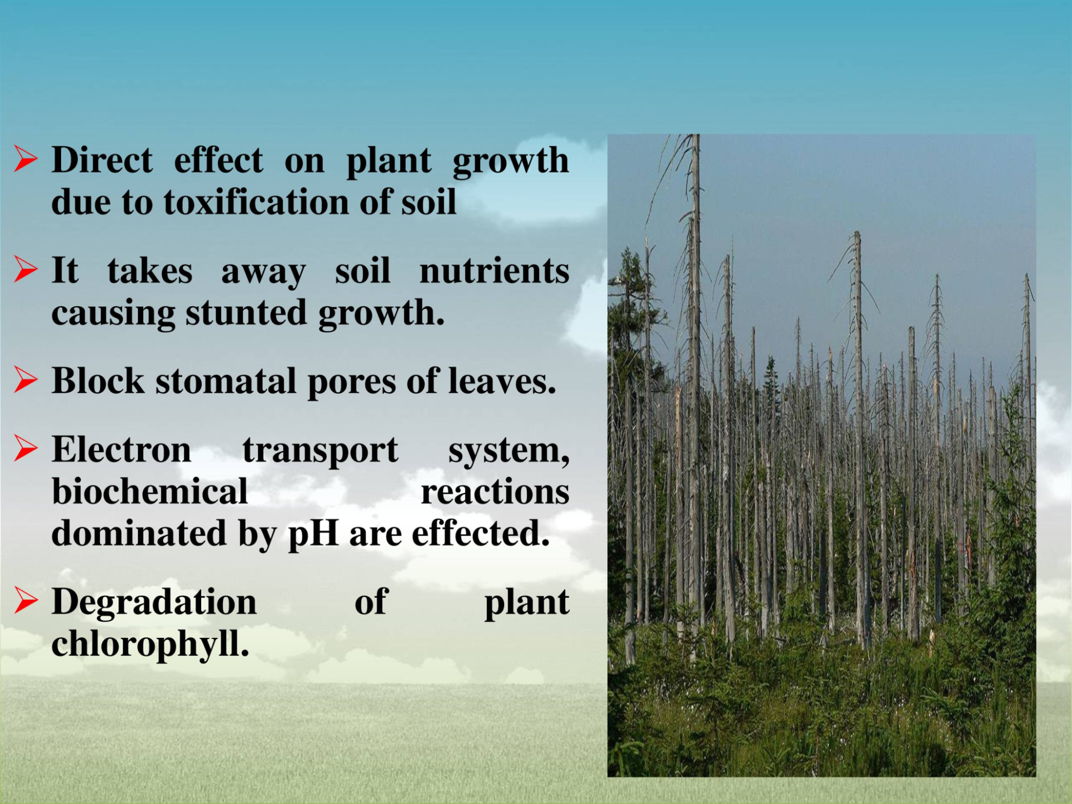
Adverse impacts/ effects of Acid Rain

Slide 21
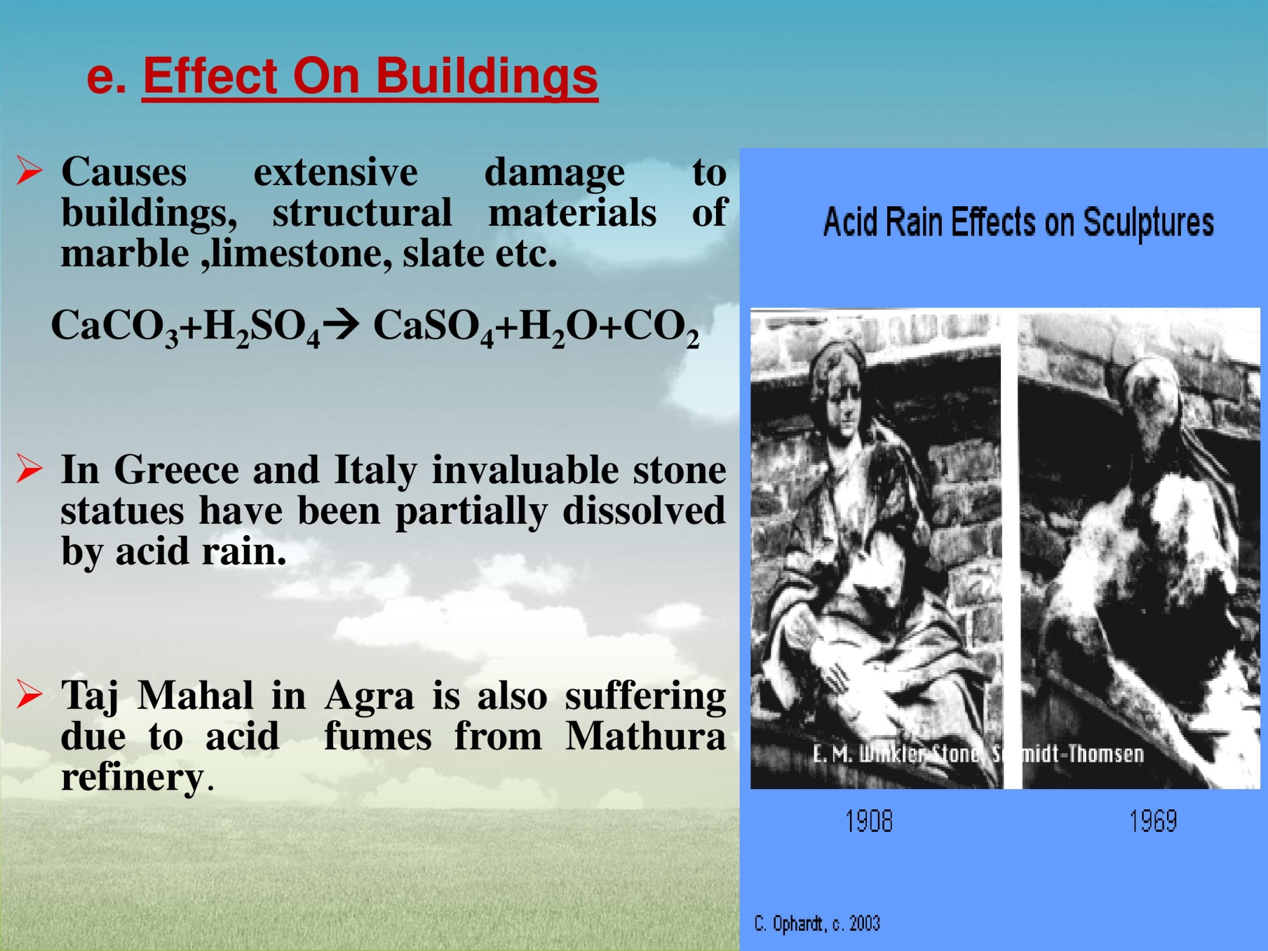
Adverse impacts/ effects of Acid Rain

Slide 22
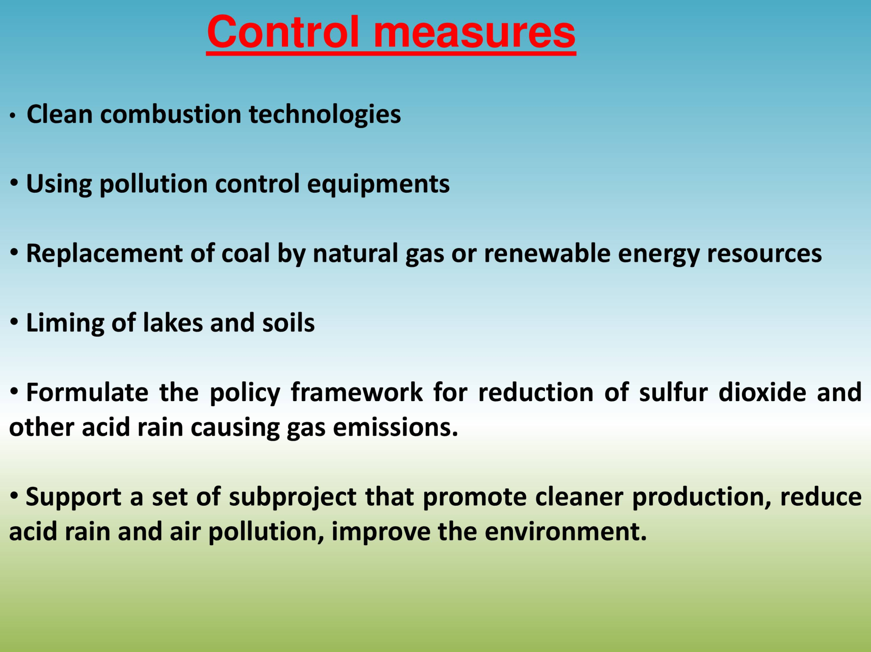
Control measures of Acid Rain

Slide 23
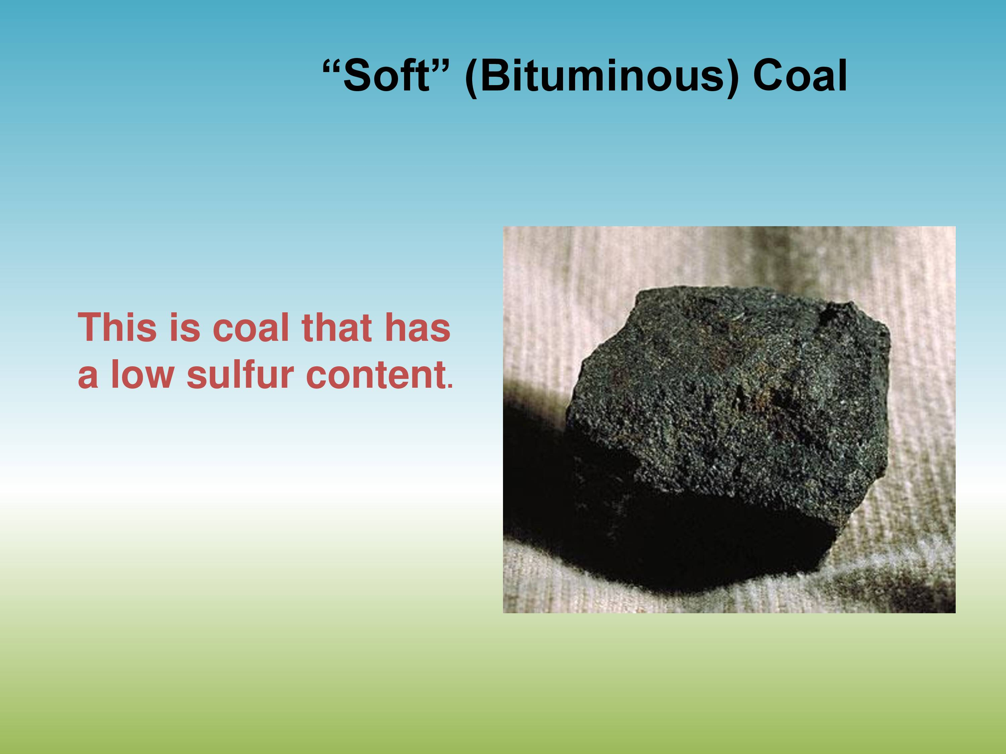

Slide 24
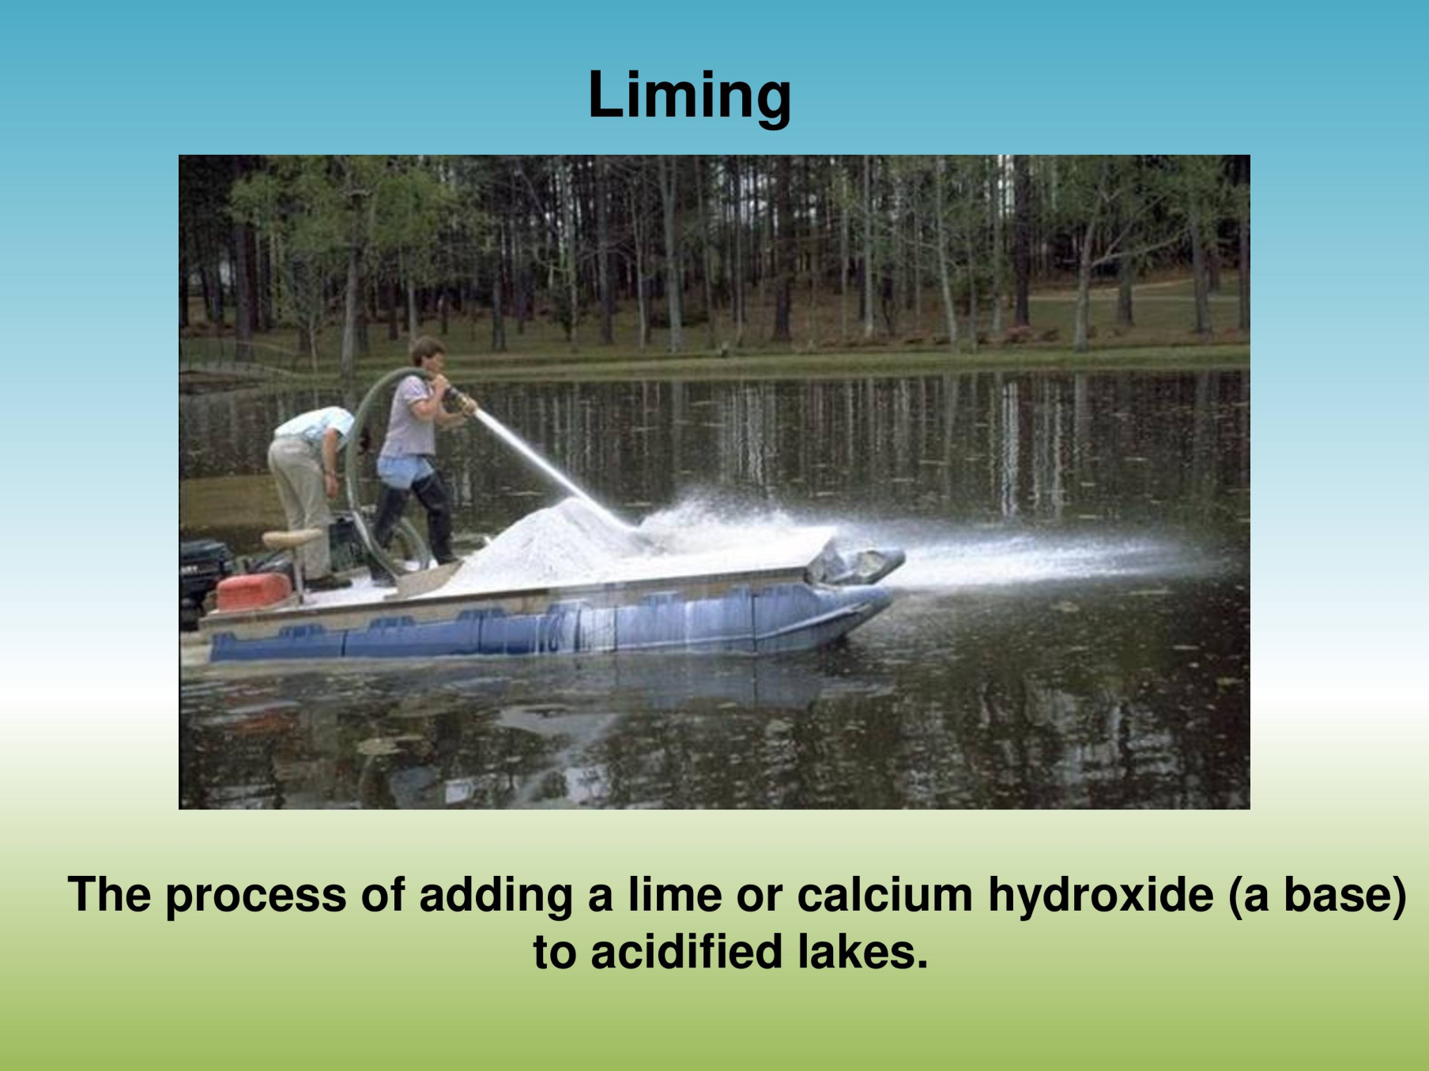

Slide 25
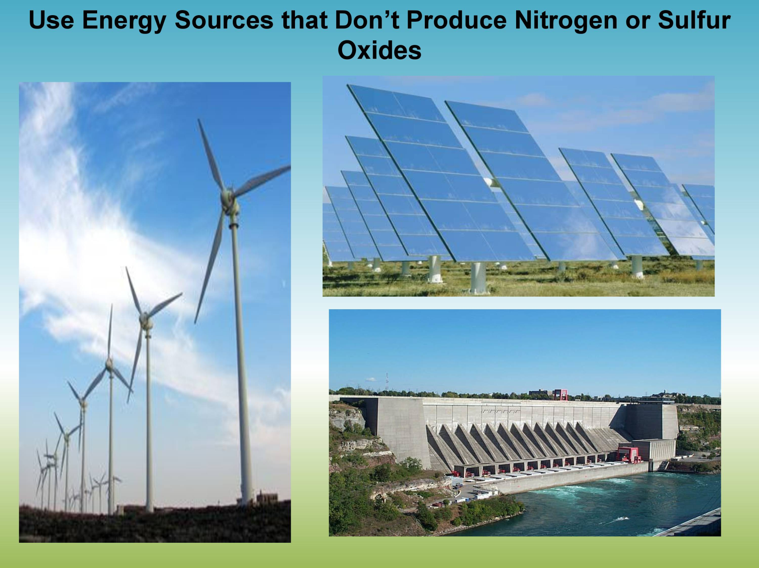

Slide 26
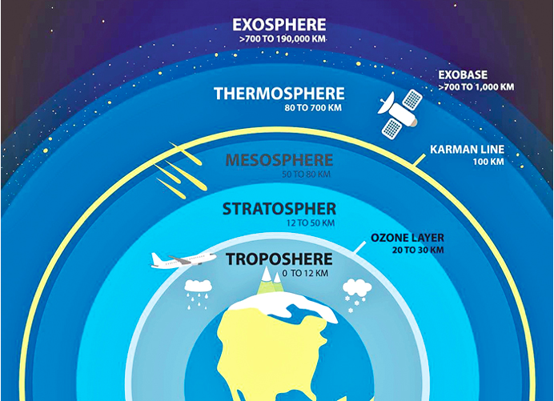
OZONE LAYER DEPLETION

Slide 27
OZONE LAYER DEPLETION
For the last 450 million years the earth has had a natural sunscreen in the stratosphere called the ozone layer.
This layer filters out harmful ultraviolet radiations from the sunlight and thus protects various life forms on the earth.
Ozone is a form of oxygen.
The molecule of oxygen contains two atoms whereas that of ozone contains three (O3).
In the stratosphere ozone is continuously being created by the absorption of short wave- length ultraviolet (UV) radiations.
Ultraviolet radiations less than 242 nanometers decompose molecular oxygen into atomic oxygen (O) by photolytic decomposition.
O2 + hv……………………………. O + O
The atomic oxygen rapidly reacts with molecular oxygen to form ozone.
O + O2 + M ......................................O3 + M
(M is a third body necessary to carry away the energy released in the reaction).

Slide 28
OZONE LAYER DEPLETION (Contd..)
Ozone thus formed distributes itself in the stratosphere and absorbs harmful ultraviolet radiations (200 to 320 nm) and is continuously being converted back to molecular oxygen.
O3 + hv …………………………………………………………..O2 + O
Absorption of UV radiations results in heating of the stratosphere.
The net result of the above reactions is an equilibrium concentration of ozone.
Ozone concentration in about 24 km of the stratosphere i.e. from 16 km to 40 Km away from earth is about 10 ppm (as compared to 0.05 ppm concentration of harmful tropospheric ozone).
This equilibrium is disturbed by reactive atoms of chlorine, bromine etc. which destroy ozone molecules and result is thinning of ozone layer generally called ozone hole.

Slide 29
OZONE LAYER DEPLETION (Contd..)
The amount of atmospheric ozone is measured by Dobson Spectrometer. and is expressed in Dobson units (DU).
One DU is equivalent to a 0.01 mm thickness of pure ozone at the density it would possess if it were brought to ground level (1atm) pressure.
Normally over temperate latitude its concentration is about 350 DU, over tropics it is 250 DU whereas at sub polar regions (except when ozone thinning occurs) it is on an average 450 DU. It is because of the stratospheric winds which transport ozone from tropical towards polar regions.

Slide 30
OZONE LAYER DEPLETION (Contd..)
Chlorofluorocarbons (CFC) are mainly responsible for ozone depletion in the stratosphere.
CFCs are a group of synthetic chemicals first discovered by Thomas Midgley Jr. in 1930. CFC-11 and CFC-12 are the CFCs most commonly used.
CFCs are used as coolants in refrigerators and air conditioners, as propellants, cleaning solvents, sterilant and in styrofoam etc.
CFCs released in the troposphere reach the stratosphere and remain there for 65-110 years destroying O3 molecules.
In 1974, Rowland and Molina warned that CFC are lowering the concentration of ozone in the stratosphere and predicted severe consequences.
It was however, in 1985 that scientists for the first time discovered that 50% (98% in some areas) of upper stratospheric ozone over Antarctica was destroyed during the Antarctic spring and early summer (September-December).
At Antarctic region the temperature during winter drops to -90°C. The winds blowing in a circular pattern over earths poles create polar vortices.

Slide 31
OZONE LAYER DEPLETION (Contd..)
Water droplets in clouds when enter these vortices form ice crystals.
CFCs get collected on the surfaces of these ice crystals and destroy ozone much faster. Similar destruction of ozone over North Pole occurs during Arctic spring and early summer (February-June).
The depletion is 10-25% and it is less than that observed at south pole.
Nitrous oxide emitted by supersonic aircrafts, during combustion of fossil fuel and use of nitrogen fertilizers breaks ozone molecules.
Chlorine liberated from chlorofluorocarbons also break ozone molecules.
The chain reaction started in Antarctic spring i.e. August/ September continues till nitrogen dioxide is liberated from nitric acid formed in the stratosphere by photolysis (breakdown by sunlight).
Nitrogen dioxide combines with chlorine and stops further destruction of ozone.

Slide 32
Effects of Ozone Depletion
Ozone depletion in the stratosphere will result in more UV radiation reaching the earth especially UV-B (290-320 nm). The UV-B radiations affect DNA and the photosynthetic chemicals. Any change in DNA can result in mutation and cancer. Cases of skin cancer (basal and squamous cell carcinoma) which do not cause death but cause disfigurement will increase.
Easy absorption of UV rays by the lens and cornea of eye will result in increase in incidents of cataract.
Melanin producing cells of the epidermis (important for human immune system) will be destroyed by UV-rays resulting in immuno-suppression. Fair people (can.t produce enough melanin) will be at a greater risk of UV exposure.
Phytoplanktons are sensitive to UV exposure. Ozone depletion will result in decrease in their population thereby affecting the population of zooplankton, fish, marine animals, in fact the whole aquatic food chain.
Yield of vital crops like corn, rice, soybean, cotton, bean, pea, sorghum and wheat will decrease.
Degradation of paints, plastics and other polymer material will result in economic loss due to effects of UV radiation resulting from ozone depletion.

